Slide 1

RETAIL DATA ANALYZED VISUALIZATIONS
BY
SAMYUKTHA S R

Slide 2
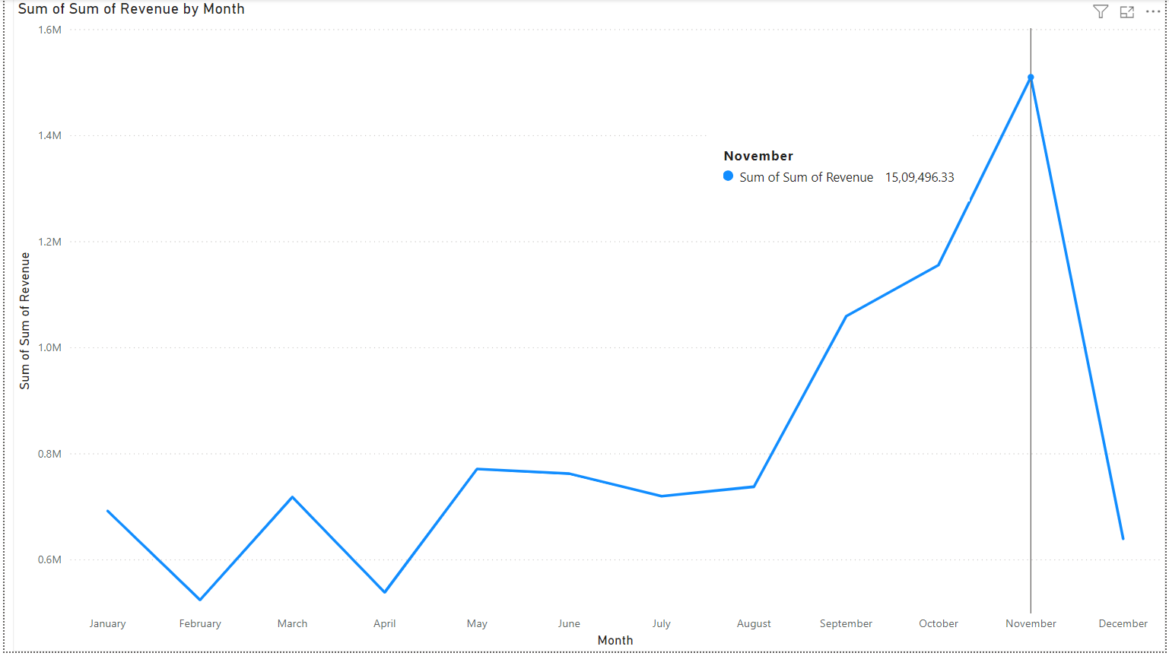
REVENUE GENERATED BY EACH MONTH IN 2011

Slide 3
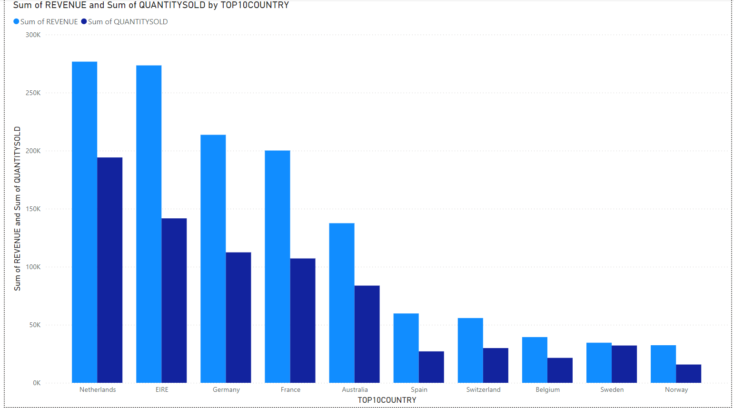
TOP 10 COUNTRIES WITH THEIR REVENUE AND UNIT SOLD

Slide 4
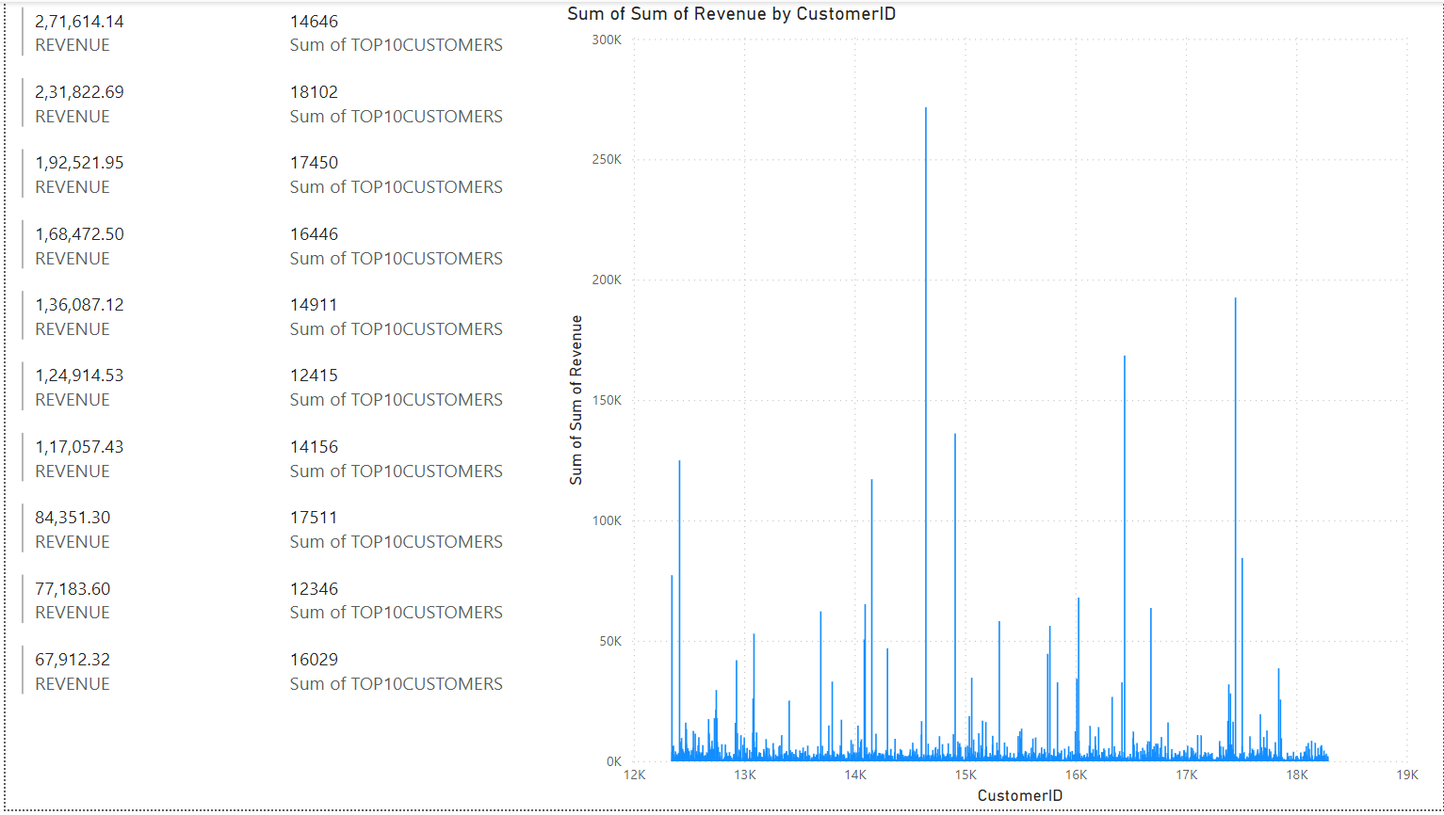
THE REVENUE OF TOP 10 CUSTOMERS & TOTAL CUSTOMERS

Slide 5
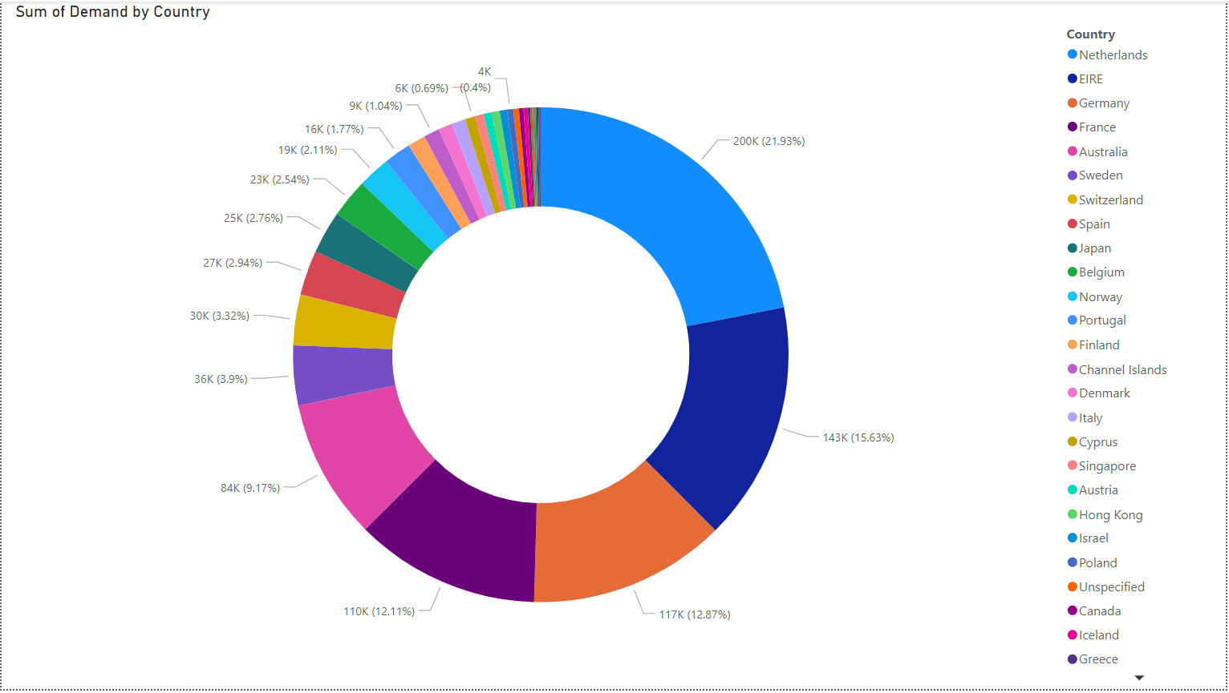
TOP DEMAND BY THE COUNTRIES

